Slide 1
Microsoft Azure Security – Open Hack
Subtitle or speaker name

Slide 2




Module 03: Data and Application Security
Azure Key Vault
Application Security
Storage Security
Database Security
Module Labs

Slide 3
Azure Key Vault

Slide 4








Azure Key Vault
Azure Key Vault Features
Key Vault Access
Key Vault Example
Key Vault Certificates
Key Vault Keys
Customer Managed Keys
Key Vault Secrets
Key Rotation
Notes:
Secure data and applications (20-25%)
Configure and manage Key Vault
Manage access to Key Vault
Manage permissions to secrets, certificates, and keys
Configure RBAC usage in Azure Key Vault
Manage certificates
Manage secrets
Configure key rotation
Backup and restore of Key Vault items

Slide 5

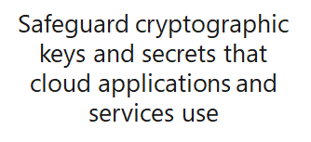
Azure Key Vault Features
Tokens, passwords, certificates, API keys, and other secrets
Public and private SSL/TLS certificates
Hardware security modules (HSMs) secrets - Premium license
Not intended for user passwords
Two service tiers—standard and premium
Notes:
About Azure Key Vault - https://docs.microsoft.com/en-us/azure/key-vault/general/overview
Key Vault is designed to store configuration secrets for server applications. It's not intended for storing data belonging to your app's users, and it shouldn't be used in the client-side part of an app. This is reflected in its performance characteristics, API, and cost model. User data should be stored elsewhere, such as in an Azure SQL database with Transparent Data Encryption, or a storage account with Storage Service Encryption. Secrets used by your application to access those data stores can be kept in Key Vault.
If a user has contributor permissions (RBAC) to a key vault management plane, they can grant themselves access to the data plane by setting a key vault access policy. It's recommended that you tightly control who has contributor access to your key vaults, to ensure that only authorized persons can access and manage your key vaults, keys, secrets, and certificates.
Azure Key Vault helps address the following issues:
Secrets management. Azure Key Vault can securely store (with HSMs) and tightly control access to tokens, passwords, certificates, API keys, and other secrets.
Key management. Azure Key Vault is a cloud-based key management solution, making it easier to create and control the encryption keys used to encrypt your data. Azure services such as App Service integrate directly with Azure Key Vault and can decrypt secrets without knowledge of the encryption keys.

Slide 6
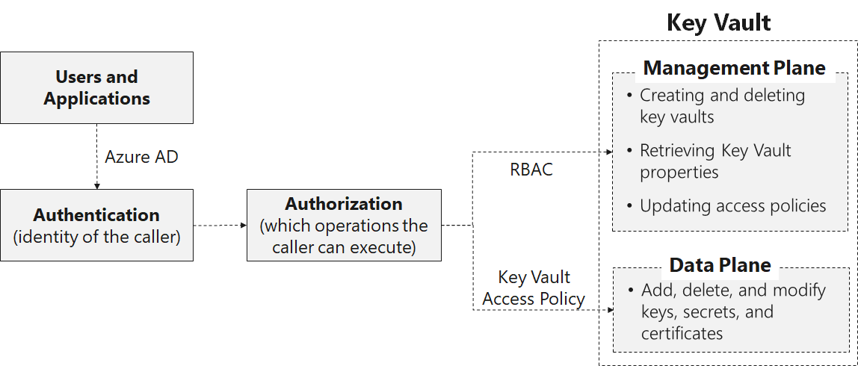
Key Vault Access
Notes:
Azure Key Vault Security - https://docs.microsoft.com/en-us/azure/key-vault/general/overview-security
Access to a key vault is controlled through two interfaces: the management plane, and the data plane. The management plane is where you manage Key Vault itself. Operations in this plane include creating and deleting key vaults, retrieving Key Vault properties, and updating access policies. The data plane is where you work with the data stored in a key vault. You can add, delete, and modify keys, secrets, and certificates from here.
To access a key vault in either plane, all callers (users or applications) must have proper authentication and authorization. Authentication establishes the identity of the caller. Authorization determines which operations the caller can execute. Both planes use Azure AD for authentication. For authorization, the management plane uses RBAC, and the data plane uses a Key Vault access policy. To access a key vault in either plane, all callers (users or applications) must have proper authentication and authorization

Slide 7
Key Vault Example
SSL certificate for SSL
Role | Management Plane | Data plane
Security team | Key Vault Contributor | Keys: backup, create, delete, get, import, list, restore Secrets: all operations
Developers and operators | Key Vault deploy permission | None
Auditors | None | Keys: list Secrets: list
Application | None | Keys: sign Secrets: get
Storage key for access the Storage account
RSA 2,048-bit key for sign in operations
Bootstrap certificate for authentication to Azure AD
Notes:
Security team
Create key vaults.
Turn on Key Vault logging.
Add keys and secrets.
Create backups of keys for disaster recovery.
Set Key Vault access policies to grant permissions to users and applications for specific operations.
Roll the keys and secrets periodically.
Developers and operators
Get references from the security team for the bootstrap and SSL certificates (thumbprints), storage key (secret URI), and RSA key (key URI) for signing.
Develop and deploy the application to access keys and secrets programmatically.
Auditors
Review the Key Vault logs to confirm proper use of keys and secrets, and compliance with data security standards.

Slide 8
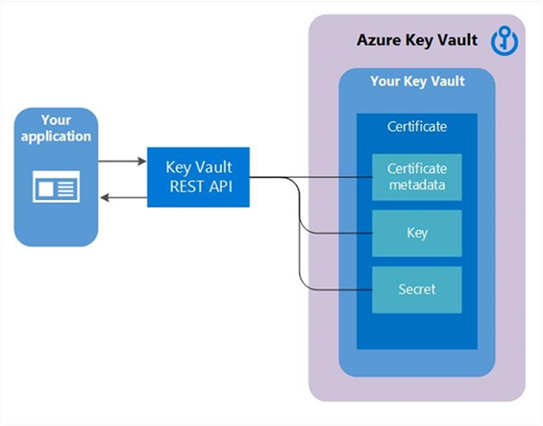
Key Vault Certificates
Manages X509 v3 certificates (PFX, PEM)
Created by the Key Vault or by import
Self-signed and Certificate Authority certificates
Lifecycle management including automatic renewal and contact notification
Minimum 2048-bit encryption
RSA or RSA HSM with certificates
Notes:
Get started with Key Vault certificates - https://docs.microsoft.com/en-us/azure/key-vault/certificates/certificate-scenarios
Key Vault certificates support provides for management of your x509 certificates and enables:
A certificate owner to create a certificate through a Key Vault creation process or through the import of an existing certificate. Includes both self-signed and CA-generated certificates.
A Key Vault certificate owner to implement secure storage and management of X509 certificates without interaction with private key material.
A certificate owner to create a policy that directs Key Vault to manage the life-cycle of a certificate.
Certificate owners to provide contact information for notification about lifecycle events of expiration and renewal of certificate.
Automatic renewal with selected issuers - Key Vault partner X509 certificate providers and CAs.
When a Key Vault certificate is created, an addressable key and secret are also created with the same name. The Key Vault key allows key operations and the Key Vault secret allows retrieval of the certificate value as a secret. A Key Vault certificate also contains public x509 certificate metadata.
The identifier and version of certificates is similar to that of keys and secrets. A specific version of an addressable key and secret created with the Key Vault certificate version is available in the Key Vault certificate response.
When a Key Vault certificate is created, it can be retrieved from the addressable secret with the private key in either PFX or PEM format. However, the policy used to create the certificate must indicate that the key is exportable. If the policy indicates non-exportable, then the private key isn't a part of the value when retrieved as a secret.
The addressable key becomes more relevant with non-exportable Key Vault certificates. The addressable Key Vault key’s operations are mapped from the keyusage field of the Key Vault certificate policy used to create the Key Vault certificate. If a Key Vault certificate expires, it’s addressable key and secret become inoperable.
Two types of key are supported – RSA or RSA HSM with certificates. Exportable is only allowed with RSA, and is not supported by RSA HSM. A certificate policy contains information on how to create and manage the Key Vault certificate lifecycle. When a certificate with private key is imported into the Key Vault, a default policy is created by reading the x509 certificate. When a Key Vault certificate is created from scratch, a policy needs to be supplied. This policy specifies how to create the Key Vault certificate version, or the next Key Vault certificate version. After a policy has been established, it’s not required with successive create operations for future versions. There's only one instance of a policy for all the versions of a Key Vault certificate.
To create self-signed certificates in Windows, use the New-SelfSignedCertificate cmdlet, which replaces deprecated makecert.exe utility. On Windows, you can use ssh-keygen.

Slide 9
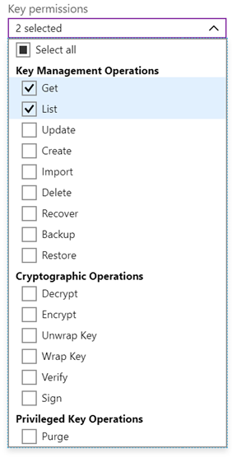
Key Vault Keys
Soft (Key vault) and Hard (HSM) keys
Supports secure transfer of existing keys in Bring Your Own Key (BYOK) scenarios
Supports operations like create, delete, update, and list
Premium supports HSM-protected keys
Supports cryptographic operations like sign and verify, key encryption/wrapping, and encrypt and decrypt
RSA and Elliptic Curve
Notes:
About Azure Key Vault Keys - https://docs.microsoft.com/en-us/azure/key-vault/keys/about-keys
Note that Azure Key Vault uses Thales nShield family of HSMs to protect their content. Explain that Key Vault allows customers to create new keys as well as upload and store their existing keys. Cryptographic keys are JSON Web Key (JWK) objects.
The process of transferring existing keys consists of the following steps:
You generate the key from an offline workstation, which reduces the attack surface.
The key is encrypted with a Key Exchange Key (KEK), which stays encrypted until transferred to the Azure Key Vault Hardware Security Modules (HSMs). Only the encrypted version of your key leaves the original workstation.
The toolset sets properties on your tenant key that binds your key to the Azure Key Vault security world. After the Azure Key Vault HSMs receive and decrypt your key, only these HSMs can use it. Your key cannot be exported. This binding is enforced by the Thales HSMs.
The KEK that encrypts your key is generated inside the Azure Key Vault HSMs, and is not exportable. The HSMs enforce that there can be no clear version of the KEK outside the HSMs. In addition, the toolset includes attestation from
Thales that the KEK is not exportable and was generated inside a genuine HSM that was manufactured by Thales. The toolset includes attestation from Thales that the Azure Key Vault security world was also generated on a genuine HSM manufactured by Thales.
Microsoft uses separate KEKs and separate security worlds in each geographical region. This separation ensures that your key can be used only in data centers in the region in which you encrypted it. For example, a key from a European customer cannot be used in data centers in North American or Asia.

Slide 10
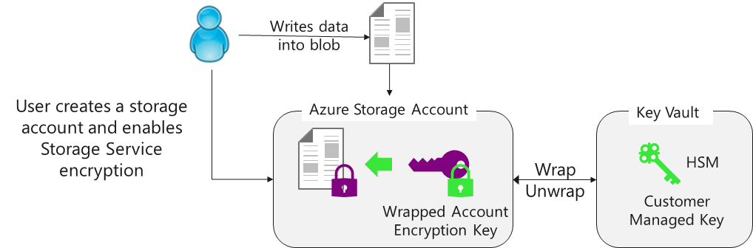
Customer Managed Keys
Update keys and secrets without affecting applications
Updates can be manual, programmatic, or automated
Notes:
Configure customer-managed keys with Azure Key Vault by using the Azure portal - https://docs.microsoft.com/en-us/azure/storage/common/storage-encryption-keys-portal
This service uses Azure Key Vault that provides highly available and scalable secure storage for RSA cryptographic keys backed by FIPS 140-2 Level 2 validated HSMs (Hardware Security Modules). Key Vault streamlines the key management process and enables customers to fully maintain control of keys that are used to encrypt data, manage, and audit their key usage, in order to protect sensitive data as part of their regulatory or compliance needs, HIPAA and BAA compliant.
Customers can generate/import their RSA key to Azure Key Vault and enable Storage Service Encryption. Azure Storage handles the encryption and decryption in a fully transparent fashion using envelope encryption in which data is encrypted using an AES based key, which is in turn protected using the Customer Managed Key stored in Azure Key Vault.
Customers can rotate their key in Azure Key Vault as per their compliance policies. When they rotate their key, Azure Storage detects the new key version and re-encrypts the Account Encryption Key for that storage account. This does not result in re-encryption of all data and there is no other action required from user.
Customers can also revoke access to the storage account by revoking access on their key in Azure Key Vault. There are several ways to revoke access to your keys. Please refer to Azure Key Vault PowerShell and Azure Key Vault CLI for more details. Revoking access will effectively block access to all blobs in the storage account as the Account Encryption Key is inaccessible by Azure Storage.
Customers can enable this feature on all available redundancy types of Azure Blob storage including premium storage and can toggle from using Microsoft managed to using customer managed keys. There is no additional charge for enabling this feature.
You can enable this feature on any Azure Resource Manager storage account using the Azure Portal, Azure PowerShell, Azure CLI, or the Microsoft Azure Storage Resource Provider API.

Slide 11
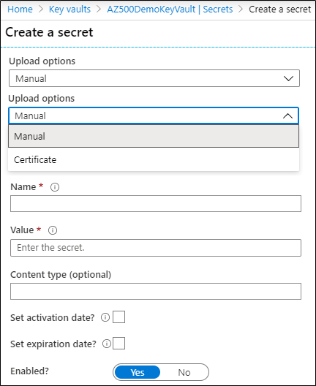
Key Vault Secrets
Name-value pair
Name must be unique in the vault
Value can be any UTF-8 string – max 25 KB in size
Manual or certificate creation
Notes:
About Azure Key Vault Secrets - https://docs.microsoft.com/en-us/azure/key-vault/secrets/about-secrets

Slide 12
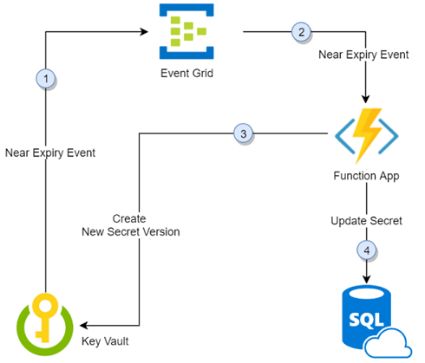
Key and Secret Rotation
Update keys and secrets without affecting your application
Rotate keys and secrets in several ways:
As part of a manual process
Programmatically with the REST API
With an Azure Automation script
Notes:
Automate the rotation of a secret for resources that use single-user/single-password authentication - https://docs.microsoft.com/en-us/azure/key-vault/secrets/tutorial-rotation
Thirty days before the expiration date of a secret, Key Vault publishes the "near expiry" event to Event Grid.
Event Grid checks the event subscriptions and uses HTTP POST to call the function app endpoint subscribed to the event.
The function app receives the secret information, generates a new random password, and creates a new version for the secret with the new password in Key Vault.
The function app updates SQL Server with the new password.
.

Slide 13
Demonstrations: Azure Key Vault
Create a Key Vault
Review Key Vault settings
Configure access policies
Notes:
In the virtual classroom consider having the students join you in doing the demonstrations. Or you could have someone share their screen and be coached through the demonstration. Consider which demonstrations to provide given your student’s interests and the labs they will be assigned.

Slide 14
Azure Dedicated HSM (Hardware Security Module)
FIPS 140-2 Level-3 compliant
Dedicated / Single device
Thales Luna 7 HSM model A790
Unique cloud-based offering from Azure
Notes:
FIPS 140-2 Level-3 compliance
Many organizations have stringent industry regulations that dictate that cryptographic keys must be stored in FIPS 140-2 Level-3 validated HSMs. Azure Dedicated HSM and a new single-tenant offering, Azure Key Vault Managed HSM (preview), help customers from various industry segments, such as financial services industry, government agencies, and others meet FIPS 140-2 Level-3 requirements. While Microsoft’s multi-tenant Azure Key Vault service currently uses FIPS 140-2 Level-2 validated HSMs.
Single-tenant devices
Many of our customers have a requirement for single tenancy of the cryptographic storage device. The Azure Dedicated HSM service enables them to provision a physical device from one of Microsoft’s globally distributed datacenters. After it's provisioned to a customer, only that customer can access the device.
Full administrative control
Many customers require full administrative control and sole access to their device for administrative purposes. After a device is provisioned, only the customer has administrative or application-level access to the device.
Microsoft has no administrative control after the customer accesses the device for the first time, at which point the customer changes the password. From that point, the customer is a true single-tenant with full administrative control and application-management capability. Microsoft does maintain monitor-level access (not an admin role) for telemetry via serial port connection. This access covers hardware monitors such as temperature, power supply health, and fan health.
The customer is free to disable this monitoring needed. However, if they disable it, they won't receive proactive health alerts from Microsoft.

Slide 15
Additional Study – Azure Key Vault
Module Review Questions
Microsoft Learn Modules (docs.microsoft.com/Learn)
Introduction to securing data at rest on Azure
Manage secrets in your server apps with Azure Key Vault (Exercise)
Configure and manage secrets in Azure Key Vault (Exercise)
Notes:
For students who may be new to Azure or are struggling with the labs consider having them use their lab time going through the Learn modules instead.
(docs.microsoft.com/Learn)
Introduction to securing data at rest on Azure - https://docs.microsoft.com/en-us/learn/modules/secure-data-at-rest/
Configure and manage secrets in Azure Key Vault - https://docs.microsoft.com/en-us/learn/modules/configure-and-manage-azure-key-vault/
Manage secrets in your server apps with Azure Key Vault - https://docs.microsoft.com/en-us/learn/modules/manage-secrets-with-azure-key-vault/

Slide 16
Application Security

Slide 17
Application Security
Microsoft Identity Platform
Azure AD Application Scenarios
App Registration
Microsoft Graph Permissions
Managed Identities
Web App Certificates
Notes:
Manage identity and access (30-35%)
Manage application access
Create App Registration
Configure App Registration permission scopes
Manage App Registration permission consent
Manage API access to Azure subscriptions and resources
Implement platform protection (15-20%)
Configure advanced security for compute
Configure security for Azure App Service

Slide 18
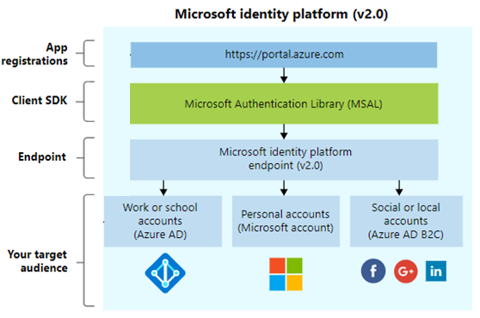
Microsoft Identity Platform
Write code once and authenticate any Microsoft identity into your application
Simple to use, provides a single sign-on experience
Use the portal to register and configure your application
Use the Microsoft Graph API for programmatic application configuration
Notes:
Microsoft Identity Platform - https://docs.microsoft.com/en-us/azure/active-directory/develop/about-microsoft-identity-platform

Slide 19
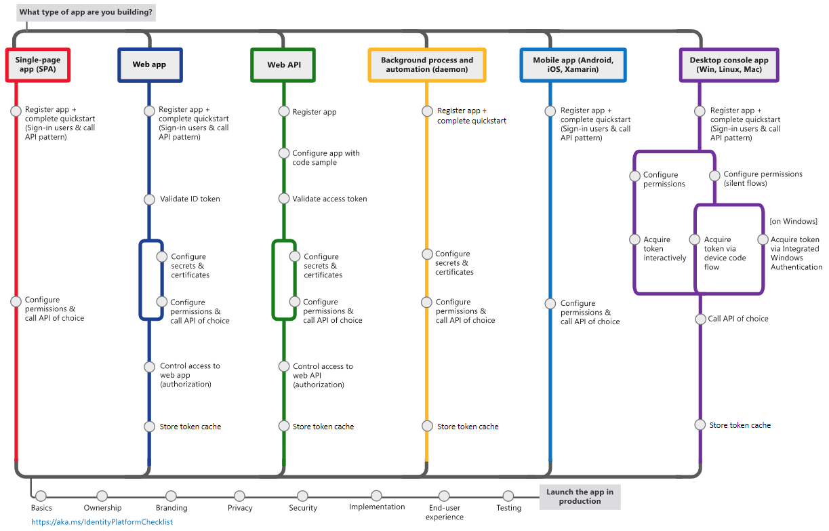
Azure AD Application Scenarios
Single page frontends that run in a browser
Web browser to a web application
Web API on behalf of a user
Web applications that need resources from a web API
Daemon or server application that needs resources from a web API
Notes:
Microsoft Identity Platform - https://docs.microsoft.com/en-us/azure/active-directory/develop/about-microsoft-identity-platform
These are the five primary application scenarios that Azure AD supports:
Single page applications - https://docs.microsoft.com/en-us/azure/active-directory/azuread-dev/single-page-application
Web apps - https://docs.microsoft.com/en-us/azure/active-directory/azuread-dev/web-app
Native apps - https://docs.microsoft.com/en-us/azure/active-directory/azuread-dev/native-app
Web API apps - https://docs.microsoft.com/en-us/azure/active-directory/azuread-dev/web-api
Service-to-Service apps - https://docs.microsoft.com/en-us/azure/active-directory/azuread-dev/service-to-service

Slide 20
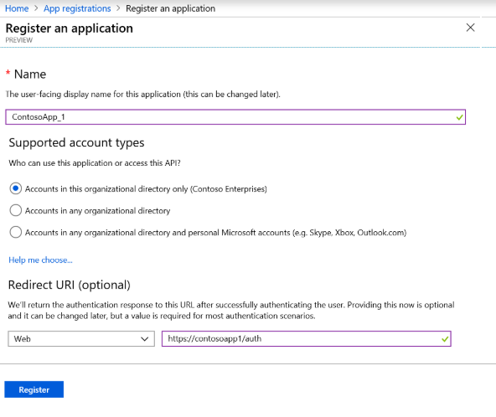
App Registration
Any application that outsources authentication to Azure AD must be registered in a directory
Registration creates token information including a unique application id, one or more endpoints, and an application secret
Notes:
Register your app with the Microsoft identity platform - https://docs.microsoft.com/en-us/graph/auth/auth-concepts#register-your-app-with-the-microsoft-identity-platform
Any application that outsources authentication to Azure AD must be registered in a directory. This step involves telling Azure AD about your application, including the URL where it’s located, the URL to send replies after authentication, the URI to identify your application, and more.
Azure AD represents applications following a specific model that's designed to fulfill two main functions:
•Identify the app according to the authentication protocols it supports - This involves enumerating all the identifiers, URLs, secrets, and related information that are needed at authentication time. Here, Azure AD:
Holds all the data required to support authentication at run time.
Holds all the data for deciding what resources an app might need to access and whether a given request should be fulfilled and under what circumstances.
Provides the infrastructure for implementing app provisioning within the app developer's tenant and to any other Azure AD tenant.
•Handle user consent during token request time and facilitate the dynamic provisioning of apps across tenants - Here, Azure AD:
Enables users and administrators to dynamically grant or deny consent for the app to access resources on their behalf.
Enables administrators to ultimately decide what apps are allowed to do and which users can use specific apps, and how the directory resources are accessed.

Slide 21
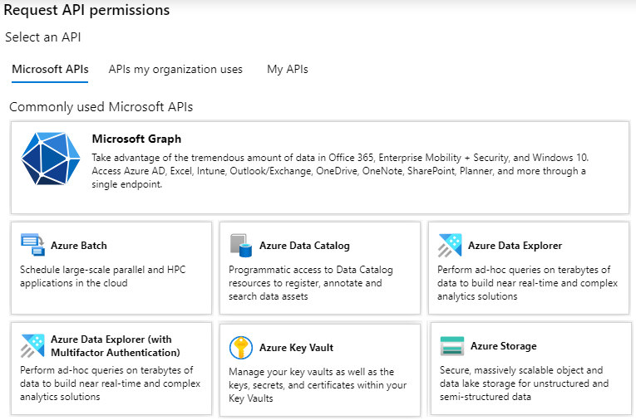
Microsoft Graph Permissions
Applications are authorized to call APIs when they are granted permissions by users/admins as part of the consent process
Delegated permissions are used by apps that have a signed-in user present
Application permissions are used by apps that run without a signed-in user present
Notes:
Microsoft Graph Permissions - https://docs.microsoft.com/en-us/graph/auth/auth-concepts#register-your-app-with-the-microsoft-identity-platform

Slide 22
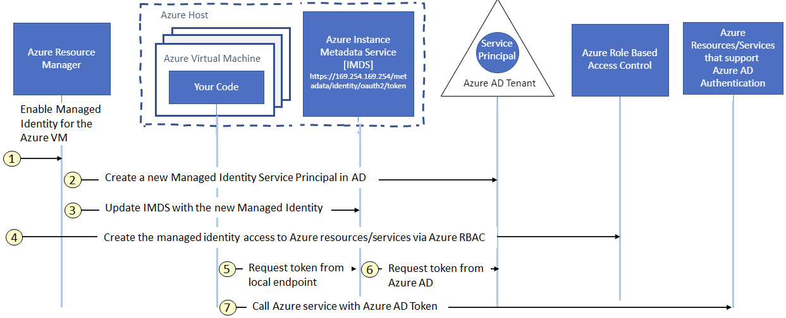
Managed Identities
Managed identities use Azure AD authentication to authenticate services – no code in the application. Identities can be system-assigned or user-assigned.
Notes:
Managed Identities - https://docs.microsoft.com/en-us/azure/active-directory/managed-identities-azure-resources/overview

Slide 23
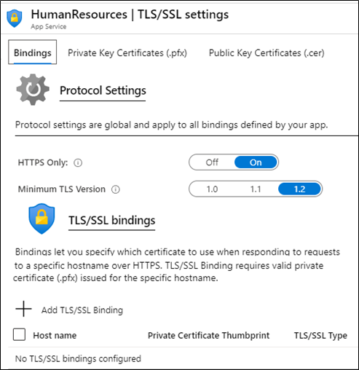
Web App Certificates
Enable require incoming certificate
Basic app plan tier or above
Requires HTTPs
Private or public certificates
Allow anonymous access with an exclusion path
Notes:
Configure TLS mutual authentication for Azure App Service - https://docs.microsoft.com/en-us/azure/app-service/app-service-web-configure-tls-mutual-auth
You can require incoming certificates from App Service > Settings > Configuration > General settings.

Slide 24
Demonstrations: Application Security
Configure an App registration via the Azure Portal
Test the application with Microsoft Graph Postman
Notes:
In the virtual classroom consider having the students join you in doing the demonstrations. Or you could have someone share their screen and be coached through the demonstration. Consider which demonstrations to provide given your student’s interests and the labs they will be assigned.

Slide 25
Additional Study – Application Security
Module Review Questions
Microsoft Learn Modules (docs.microsoft.com/Learn)
Authenticate apps to Azure services by using service principals and managed identities for Azure resources (Exercise)
Secure your application by using OpenID Connect and Azure AD (Exercise)
Permissions and Consent Framework (Exercise)
Application types in Microsoft identity (Exercise)
Notes:
For students who may be new to Azure or are struggling with the labs consider having them use their lab time going through the Learn modules instead.
(docs.microsoft.com/Learn)
Authenticate apps to Azure services by using service principals and managed identities for Azure resources - https://docs.microsoft.com/en-us/learn/modules/authenticate-apps-with-managed-identities/
Secure your application by using OpenID Connect and Azure AD - https://docs.microsoft.com/en-us/learn/modules/secure-app-with-oidc-and-azure-ad/
Permissions and Consent Framework - https://docs.microsoft.com/en-us/learn/modules/identity-permissions-consent/
Application types in Microsoft identity - https://docs.microsoft.com/en-us/learn/modules/identity-application-types/

Slide 26
Storage Security

Slide 27


Storage Security
Data Sovereignty
Azure Storage Access
Shared Access Signatures
Azure AD Storage Authentication
Storage Service Encryption
Blob Data Retention Policies
Azure Files Authentication
Secure Transfer Required
Notes:
Secure data and applications (20-25%)
Configure security for storage
Configure access control for storage accounts
Configure key management for storage accounts
Configure Azure AD authentication for Azure Storage
Configure Azure AD Domain Services authentication for Azure Files
Create and manage Shared Access Signatures (SAS)
Create a shared access policy for a blob or blob container
Configure Storage Service Encryption

Slide 28

Data Sovereignty
Physical isolation
Geography
Regional Pair
Platform-provided replication
Region
Region
Region recovery order
Datacenter(s)
Datacenter(s)
Sequential updates
Data residency
Facilitates compliance with data location laws
Notes:
Questions on data residency and compliance in Microsoft Azure? - https://azure.microsoft.com/en-us/blog/questions-on-data-residency-and-compliance-in-azure-we-got-answers/
Start by explaining the concept of data sovereignty. You can use for this purpose its Microsoft definition:
“Data sovereignty is the concept that information which has been converted and stored in binary digital form is subject to the laws of the country in which it is located. Many of the current concerns that surround data sovereignty relate to enforcing privacy regulations and preventing data that is stored in a foreign country from being subpoenaed by the host country’s government. “
Next, explain the principle of Azure region pairing. Azure operates in multiple geographies around the world. An Azure geography is a defined area of the world that contains at least one Azure Region. An Azure region is an area within a geography, containing one or more datacenters. Each Azure region is paired with another region within the same geography, forming a regional pair. The exception is Brazil South, which is paired with a region outside its geography. Across the region pairs Azure serializes platform updates (or planned maintenance), so that only one paired region is updated at a time. In the event of an outage affecting multiple regions, one region in each pair will be prioritized for recovery.
Finally, explain the benefits of paired regions.
The first benefit is physical isolation. When possible, Azure services prefers at least 300 miles of separation between datacenters in a regional pair (although this isn't practical or possible in all geographies). Physical datacenter separation reduces the likelihood of both regions being affected simultaneously as a result of natural disasters, civil unrest, power outages, or physical network outages. Isolation is subject to the constraints within the geography, such as geography size, power and network infrastructure availability, and regulations.
The second benefit is platform-provided replication. Some services such as geo-redundant storage provide automatic replication to the paired region.
The third benefit ties to region recovery order. In the event of a broad outage, recovery of one region is prioritized out of every pair. Applications that are deployed across paired regions are guaranteed to have one of the regions recovered with priority. If an application is deployed across regions that are not paired, recovery might be delayed. In the worst case the chosen regions might be the last two to be recovered.
The fourth benefit is associated with sequential updates. Planned Azure system updates are rolled out to paired regions sequentially, not at the same time. This helps minimize downtime, the effect of bugs, and logical failures in the rare event of a bad update.
The sixth benefit is data residency. To meet data residency requirements for tax and law enforcement jurisdiction purposes, a region resides within the same geography as its pair, with the exception of Brazil South.

Slide 29
Azure Storage Access
Every storage request must be authorized. There are various authorization methods, including anonymous.
Storage | Storage Account Shared Key | Shared access signature | Azure Active Directory | Active Directory | Anonymous public read access
Azure Blobs | Supported | Supported | Supported | Not supported | Supported
Azure Files (SMB) | Supported | Not supported | Supported, only with Azure AD Domain Services | Supported, credentials must be synced to Azure AD | Not supported
Azure Files (REST) | Supported | Supported | Not supported | Not supported | Not supported
Notes:
Authorize requests to Azure Storage - https://docs.microsoft.com/en-us/rest/api/storageservices/authorize-requests-to-azure-storage
More details on the next slides, just introduce the choices. Every request made against a secured resource in the Blob, File, Queue, or Table service must be authorized. Authorization ensures that resources in your storage account are accessible only when you want them to be, and only to those users or applications to whom you grant access. You can authorize requests for Azure Storage by using Azure AD, Access Keys, and Shared Access Signatures. You also have the option of enabling anonymous access.
Instructor Note – Azure Files Azure AD Authentication is no longer in preview -- General availability of Azure Files on-premises Active Directory Domain Services authentication | Azure Blog and Updates | Microsoft Azure

Slide 30
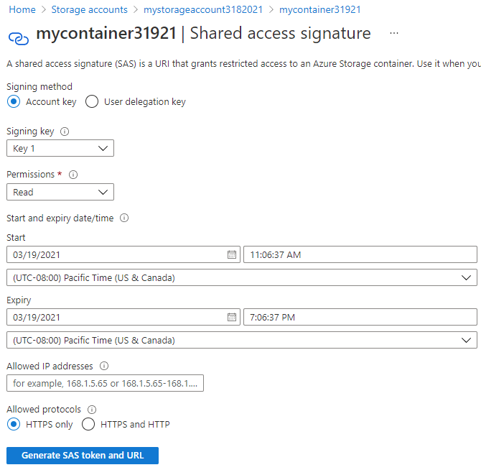
Shared Access Signatures
Digitally signed URIs of target storage resources
Grants access to clients without sharing your storage account keys
SAS types:
Account – multiple storage service
Service – single storage service
User delegation – blob only
Configure permissions, start/expiry times, IP addresses, and allowed protocols
Notes:
Shared Access Signatures - https://docs.microsoft.com/en-us/rest/api/storageservices/delegate-access-with-shared-access-signature
Instructor Note → Combine SAS with a stored access policy to add an additional level of security and protection.
Instructor Note2 → This UI is showing creating a SAS item in Blob / Container storage, so you get the User Delegation key as an option. You will not see this option in other places.
A SAS provides delegated access to resources in your storage account. With an SAS, you can grant clients access to resources in your storage account, without sharing your account keys, which is the key point of using SAS in your applications—SAS is a secure way to share your storage resources without compromising your account keys.
SAS gives you granular control over the type of access you grant to clients who have the SAS, including:
• The interval over which the SAS is valid, including the start time and the expiry time.
• The permissions granted by the SAS. For example, an SAS for a blob might grant read and write permissions to that blob, but not delete permissions.
• An optional IP address or range of IP addresses from which Azure Storage will accept the SAS. For example, you might specify a range of IP addresses belonging to your organization.
• The protocol over which Azure Storage will accept the SAS. You can use this optional parameter to restrict access to clients using HTTPS.
Explain that you can create two types of SAS’s:
• Service SAS. The service SAS delegates access to a resource in just one of the storage services: Blob, Queue, Table, or File service.
• Account SAS. The account SAS delegates access to resources in one or more of the storage services. All of the operations available via a service SAS are also available via an account SAS. Additionally, with the account SAS, you can delegate access to operations that apply to a given service, such as Get/Set Service Properties and Get Service Stats. You can also delegate access to read, write, and delete operations on blob containers, tables, queues, and file shares that are not permitted with a service SAS.
Describe two common design patterns where an SAS is useful is a service where users read and write their own data to your storage account.
In the first pattern, clients upload and download data via a front-end proxy service that performs authentication. This front-end proxy service has the advantage of allowing validation of business rules, but for large amounts of data or high-volume transactions, creating a service that can scale to match demand could be expensive or difficult.
In the second pattern, a lightweight service authenticates the client as needed and then generates an SAS. After the client receives the SAS, they can access storage account resources directly using the permissions defined by the SAS and the interval allowed by the SAS. The SAS mitigates the need for routing all data through the front-end proxy service.
Note that many real-world services use a hybrid of these two approaches. For example, some data might be processed and validated via the front-end proxy, while other data is saved and read (or just read) directly using SAS.
A user delegation SAS, introduced with version 2018-11-09. A user delegation SAS is secured with Azure AD credentials. This type of SAS is supported for the Blob service only and can be used to grant access to containers and blobs. For more information, see Create a user delegation SAS.

Slide 31
Azure AD Storage Authentication
Available for Blob and Queue storage
Several built-in roles including Data Owner, Data Contributor, and Data Reader
Two-step process: authentication (token returned) and then authorization
Scope from Management Group down to individual blob or queue
Notes:
Authorize access to blobs and queues using Azure Active Directory - https://docs.microsoft.com/en-us/azure/storage/common/storage-auth-aad
With AAD authentication, you can now use Azure’s role-based access control framework to grant specific permissions to users, groups and applications down to the scope of an individual blob container or queue. This capability extends the existing Shared Key and SAS Tokens authorization mechanisms.
Provides built-in roles for authorizing access to blob and queue data using Azure AD and Oauth.
Provides scope from Management Groups down to individual containers and queues.
Available for all general-purpose and Blob storage accounts in all public regions and national clouds.
With Azure AD, access to a resource is a two-step process. First, the security principal's identity is authenticated, and an OAuth 2.0 token is returned. Next, the token is passed as part of a request to the Blob or Queue service and used by the service to authorize access to the specified resource.
Note that it can take up to 5 minutes for the RBAC permissions to propagate.

Slide 32
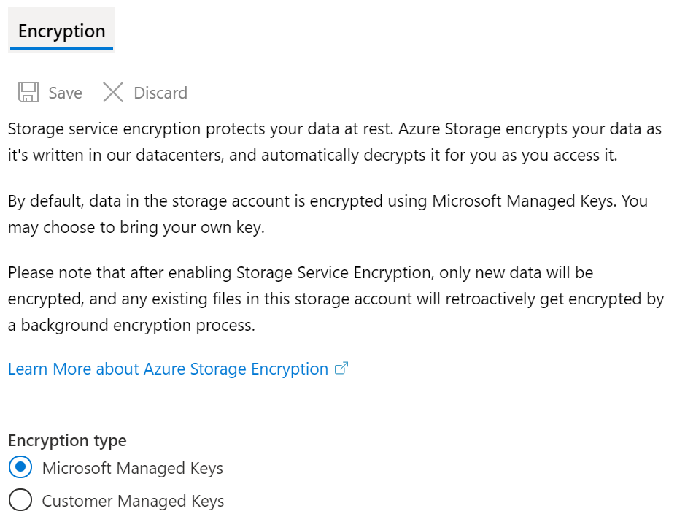
Storage Service Encryption
Protects your data for security and compliance
Automatically encrypts and decrypts your data
Encrypted through 256-bit AES encryption
Is enabled for all new and existing storage accounts and cannot be disabled
Is transparent to users
Notes:
Storage Service Encryption - https://docs.microsoft.com/en-us/azure/storage/common/storage-service-encryption
Azure SSE for data at rest helps you protect your data to meet your organizational security and compliance commitments. With this feature, the Azure storage platform automatically encrypts your data before persisting it to Azure Managed Disks, Azure Blob, Queue, or Table storage, or Azure Files, and decrypts the data before retrieval. Managing encryption, encryption at rest, decryption, and key management in SSE is transparent to users. All data written to the Azure storage platform is encrypted through 256-bit Advanced Encryption Standard (AES) encryption, one of the strongest block ciphers available.
SSE is enabled for all new and existing storage accounts and cannot be disabled. Because your data is secured by default, you don't need to modify your code or applications to utilize SSE.
SSE automatically encrypts data in Azure Managed Disks, Azure Blob storage, Azure Files, Azure Queue storage, Azure Table storage. It supports both storage performance tiers (Standard and Premium) and both deployment models (Resource Manager and classic).
Note that SSE does not have meaningful impact on the performance of Azure storage services.
You can use Microsoft-managed encryption keys with SSE, or you can use your own encryption keys.

Slide 33
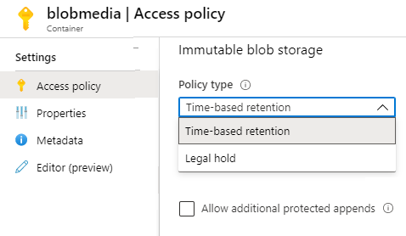
Blob Data Retention Policies
Data recovery and disposal rules
Time-based retention for a specified interval (days)
Legal-hold retention based on tags – no editing or deleting of the content
Container policies apply to all existing and new content
Supports audit logging
Notes:
Set and manage immutability policies for Blob storage – https://docs.microsoft.com/en-us/azure/storage/blobs/storage-blob-immutability-policies-manage?tabs=azure-portal
Data recovery and disposal, like data reclassification, is an essential aspect of managing data assets. The principles for data recovery and disposal are defined by a data retention policy and enforced in the same manner as data reclassification. These tasks are typically performed by the custodian and administrator roles as a collaborative task.
Failure to maintain a data retention policy could mean data loss, or failure to comply with regulatory and legal discovery requirements. Most organizations that do not have a clearly defined data retention policy tend to use a default, Keep everything retention policy. However, this poses additional risks in cloud services scenarios. For example, a data retention policy for cloud service providers can be considered as “for the duration of the subscription,” meaning as long as the service is paid for, the data is retained. Such a pay-for-retention agreement might not address corporate or regulatory retention policies. A data retention policy should address the required regulatory and compliance requirements, and corporate legal retention requirements. Classified data might provoke questions about retention duration and exceptions for data that has been stored with a provider, although such questions most likely pertain to data that has not been classified correctly. Data classification rules that pertain to data retention must be addressed when moving to the cloud, and that cloud solutions can help mitigate risk. Some data protection technologies such as encryption, rights management, and data loss prevention solutions can help mitigate cloud risks.
Point out that immutable storage is available in Azure in the form that leverages Azure Blob Storage. It allows for blobs to be created and read, but not modified or deleted, for the duration of the retention interval.
The immutable storage provides support for a number of important features.
The first of these features is time-based retention policy support. It allows users to set policies to store data for a specified interval.
The second feature is legal hold policy support. When the retention interval is not known, users can set legal holds to store data immutably until the legal hold is cleared. When a legal hold is set, blobs can be created and read, but not modified or deleted. Each legal hold is associated with a user-defined alphanumeric tag that is used as an identifier string, such as a case ID.
The next feature is support for all blob tiers. WORM policies are independent of the Azure Blob Storage tier and apply to all tiers: hot, cool, and archive. Users can transition data to the most cost-optimized tier for their workloads while maintaining data immutability.
Another feature is container-level configuration. Users can configure time-based retention policies and legal hold tags at the container level. By using simple container-level settings, users can create and lock time-based retention policies, extend retention intervals, set and clear legal holds, and more. These policies apply to all the blobs in the container, both existing and new.
Last, but not least, there is support for audit logging. Each container includes an audit log, which displays up to five time-based retention commands for locked time-based retention policies. The audit log is retained for the lifetime of the container. The Azure Activity Log shows a comprehensive log of all the control plane activities. It is the user's responsibility to store those logs persistently, as might be required for regulatory or other purposes.

Slide 34



Azure Files Authentication
Enable identity-based authentication
1
Azure AD
Domain Services
Authenticate with AAD credentials
Use Azure AD DS or on-premises AD DS (preview)
3
Return Kerberos ticket
2
Use RBAC roles to assign access rights to the file shares
4
Enforces standard Windows file permissions at both the directory and file level
Access Azure Files
Azure VM
Azure Files
Notes:
Overview of Azure Files identity-based authentication support for SMB access - https://docs.microsoft.com/en-us/azure/storage/files/storage-files-active-directory-overview
Before you can enable authentication on Azure file shares, you must first set up your domain environment. For Azure AD DS authentication, you should enable Azure AD Domain Services and domain join the VMs you plan to access file data from. Your domain-joined VM must reside in the same virtual network (VNET) as your Azure AD DS. Similarly, for on-premises AD DS authentication, you need to set up your domain controller and domain join your machines or VMs.
When an identity associated with an application running on a VM attempts to access data in Azure file shares, the request is sent to Azure AD DS to authenticate the identity.
If authentication is successful, Azure AD DS returns a Kerberos token.
The application sends a request that includes the Kerberos token, and Azure file shares use that token to authorize the request. Azure file shares receive the token only and does not persist Azure AD DS credentials.

Slide 35
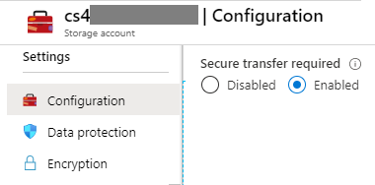
Secure Transfer Required
Storage account connections must be secure (HTTPs)
Existing Account
HTTPs for custom domain names not supported
Azure Files connections require encryption (SMB)
Notes:
https://docs.microsoft.com/en-us/azure/storage/common/storage-require-secure-transfer
Because Azure Storage doesn't support HTTPS for custom domain names, this option is not applied when you're using a custom domain name. And classic storage accounts are not supported.

Slide 36
Demonstrations: Storage Security
Generate SAS tokens
Key rollover
Storage access policies
Azure AD user account authentication
Storage endpoints
Notes:
In the virtual classroom consider having the students join you in doing the demonstrations. Or you could have someone share their screen and be coached through the demonstration. Consider which demonstrations to provide given your student’s interests and the labs they will be assigned.

Slide 37
Additional Study – Storage Security
Module Review Questions
Microsoft Learn Modules (docs.microsoft.com/Learn)
Core Cloud Services - Azure data storage options
Create an Azure Storage account (Exercise)
Control access to Azure Storage with shared access signatures (Exercise)
Store and share files in your application with Azure Files (Exercise)
Secure your Azure Storage account
Notes:
For students who may be new to Azure or are struggling with the labs consider having them use their lab time going through the Learn modules instead.
(docs.microsoft.com/Learn)
Core Cloud Services - Azure data storage options - https://docs.microsoft.com/en-us/learn/modules/intro-to-data-in-azure/
Create an Azure Storage account - https://docs.microsoft.com/en-us/learn/modules/create-azure-storage-account/
Store and share files in your application with Azure Files - https://docs.microsoft.com/en-us/learn/modules/store-and-share-with-azure-files/
Secure your Azure Storage account - https://docs.microsoft.com/en-us/learn/modules/secure-azure-storage-account/
Control access to Azure Storage with shared access signatures - https://docs.microsoft.com/en-us/learn/modules/control-access-to-azure-storage-with-sas/

Slide 38
Database Security
Notes:
In the first lesson of this module, you will learn configuring security policies to manage data.

Slide 39




Database Security
Data Sovereignty
SQL Database Authentication
SQL Database Firewalls
Database Auditing
Data Discovery and Classification
Vulnerability Assessment
Advanced Threat Protection
Dynamic Data Masking
Transparent Data Encryption
Always Encrypted
Notes:
Network Security – Firewall
Access Management – Database Authentication
Threat Protection – Database Auditing, Advanced Threat Protection
Information Protection – Always Encrypted, Transparent Data Encryption, Dynamic Data Masking
Security Management – Data Discovery and Classification, Vulnerability Assessment
Secure data and applications (20-25%)
Configure security for databases
Enable database authentication
Enable database auditing
Configure Azure SQL Database Advanced Threat Protection
Configure security for Azure SQL
Implement database encryption
Implement Azure SQL Database Always Encrypted

Slide 40




SQL Database Authentication
An alternative to SQL Server authentication
Azure AD Database Administrator
Helps stop the proliferation of user identities across database servers
SQL Database Administrator
Allows password rotation in a single place
Azure AD
Customers can manage database permissions using external (Azure AD) groups
Azure AD
Database users mapped to Azure AD identities
Notes:
Authorizing database access to authenticated users to SQL Database and Azure Synapse Analytics using logins and user accounts - https://docs.microsoft.com/en-us/azure/sql-database/sql-database-manage-logins
Point out that SQL Database supports two types of authentication.
SQL authentication uses a username and password. When creating the SQL Database server, it is necessary to specify a server admin login with a username and password. These credentials can be used to authenticate to any database on that server as the database owner.
Azure Active Directory (AD) authentication uses identities managed by Azure AD, and is supported for managed and integrated domains. In order to use Azure AD authentication, it is necessary to create another server admin called Azure AD admin. This admin is allowed to administer Azure AD users and groups, in addition to performing all operations that a regular server admin can.
Regardless of the authentication method, you can create two types of database users. More specifically, you can create user accounts in the master database, and grant permissions in all databases on the server, or you can create them in the database itself. The latter represent so called contained database users. By using database contained users, you enhance database portability.
Point out that Azure Cosmos DB does not facilitate user-based authentication – but instead, uses hash message authentication code for authorization. Each request is hashed using the secret account key, and the subsequent base-64–encoded hash is sent with each call to Cosmos DB. To validate the request, the Cosmos DB service uses the correct secret key and properties to generate a hash. It then compares the value with the one in the request. If the two values match, the operation is authorized and the request is processed. If the values don’t match, an authorization failure occurs, and the request is rejected.
Customers can use either a master key, or a resource token to allow fine-grained access to a resource such as a document. Using the master key, it is possible to create user resources and permission resources per database. A resource token is associated with a permission in a database. It determines whether the user has access (read-write, read-only, or no access) to an application resource in the database such as container, documents, attachments, stored procedures, triggers, and User Defined Functions The resource token is then used during authentication to provide or deny access to the resource.
Describe the sequence of steps involved in enabling Azure AD authentication for Azure SQL Database. Point out that this example illustrates a hybrid scenario, but it is also possible to use Azure AD cloud identities. Azure AD authentication facilitates centralized management of database users and simplifies permissions management. As the result, it becomes easier to stop the proliferation of user identities across database servers.
The following high-level steps explain how to configure and use Azure Active Directory authentication:
Create and populate Azure AD.
Optionally, associate or change the Azure AD tenant associated with the target Azure Subscription.
Create an Azure AD administrator for the Azure SQL Database server, the Managed Instance, or the Azure SQL Data Warehouse.
Configure client computers.
Create contained database users mapped to Azure AD identities in the target database.
Connect to the database by using Azure AD identities.

Slide 41
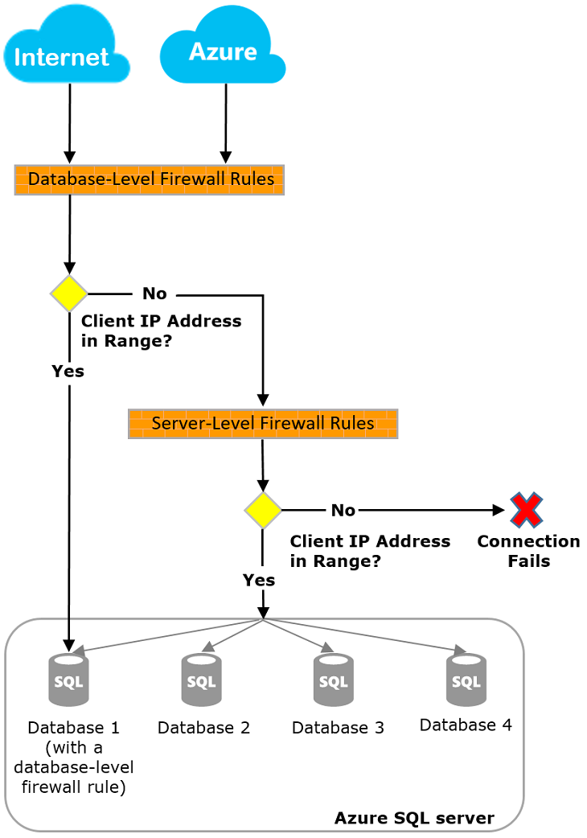
SQL Database Firewalls
By default, firewall denies all access
1
2
Database-level firewall rules add allowed client IP addresses and/or all Azure services and resources
3
Server-level firewall rules are added programmatically – subnet of the database level clients
Notes:
Azure SQL Database and Azure SQL Data Warehouse IP firewall rules - https://docs.microsoft.com/en-us/azure/sql-database/sql-database-firewall-configure
Azure SQL Database and Azure SQL Data Warehouse provide a relational database service for Azure and other internet-based applications. To help protect data, firewalls prevent all access to your database server until customers explicitly specify which computers have permission. The firewall grants access to databases based on the originating IP address of each request. In addition to IP rules, the firewall also manages virtual network rules. Virtual network rules are based on virtual network service endpoints.
Explain that in order to selectively grant access to just one of the databases hosted by the same Azure SQL Database server, it is necessary to create a database-level rule for the required database. This involves specifying an IP address range for the database IP firewall rule that is beyond the IP address range specified in the server-level IP firewall rule, and ensuring that the IP address of the client falls in the range specified in the database-level rule.
Point out that SQL Data Warehouse only supports server-level IP firewall rules, and not database-level IP firewall rules.
Note that to allow applications from Azure to connect to your Azure SQL Database, Azure connections must be enabled. When an application from Azure attempts to connect to your database server, the firewall verifies that Azure connections are allowed.
Emphasize that database-level IP firewall rules enable clients to access certain secure databases within the same SQL Database server, however, such rules need to be created by using Transact-SQL statements, after server-level firewall have been configured.
When presenting this slide, demonstrate how to configure a SQL Database server-level firewall rule from the Azure portal.

Slide 42
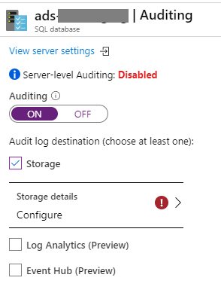
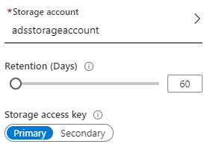
Database Auditing
Retain an audit trail of selected events
Report on database activity and analyze results
Configure policies for the server or database level
Configure audit log destination
A new server policy applies to all existing and newly created databases
Notes:
Azure SQL Auditing - https://docs.microsoft.com/en-us/azure/sql-database/sql-database-auditing
You can use SQL database auditing to retain an audit trail of selected events, including defining categories of database actions to be audited, report on database activity, using preconfigured reports and a dashboard to get started quickly with activity and event reporting, and analyze reports that help identifying suspicious events, unusual activity, and trends.
You can define an auditing policy for a specific database, or as a default server policy. A server policy applies to all existing and newly created databases on the server.
If server blob auditing is enabled, it always applies to the database. The database will be audited regardless of the database auditing settings. Enabling blob auditing on the database or data warehouse—in addition to enabling it on the server—does not override or change any of the settings of the server blob auditing. Both audits will exist side by side.
As a best practice, avoid enabling both server blob auditing and database blob auditing together, unless you want to use a different storage account or retention period for a specific database or unless you want to audit event types or categories for a specific database that differs from the rest of the databases on the server. For example, you might have table inserts that need to be audited but only for a specific database.
Demonstrate how to enable database auditing by using the Azure portal. You need to use Azure PowerShell or REST API to customize audited events

Slide 43
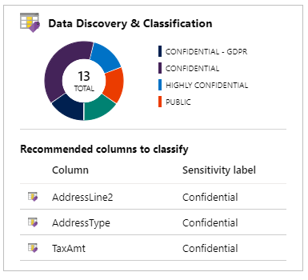
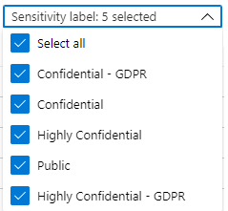
Data Discovery and Classification
Built-in to Azure SQL Database
Scans your database and identifies columns that contain potentially sensitive data
Provides classification recommendations and reports
Let's you apply sensitivity-classification labels
Notes:
Data Discovery & Classification for Azure SQL Database and Azure Synapse Analytics - https://docs.microsoft.com/en-us/azure/sql-database/sql-database-data-discovery-and-classification
Explain that classifying data and identifying data protection needs helps select the right cloud solution. Data classification enables organizations to find storage optimizations that might not be possible when all data is assigned the same value. Classifying stored data by sensitivity and business impact helps organizations determine the risks associated with the data. After data has been classified, organizations can manage their data in ways that reflect their internal value instead of treating all data the same way. Data classification can yield benefits such as compliance efficiencies, improved ways to manage the organization’s resources, and facilitation of migration to the cloud. Some data protection solutions—such as encryption, rights management, and data loss prevention—have moved to the cloud and can help mitigate cloud risks. However, organization must be sure to address data classification rules for data retention when moving to the cloud.
It is important to note that data classification applies regardless of data state and data format and data state.
Data discovery and classification is part of the Advanced Data Security offering, which is a unified package for advanced Microsoft SQL Server security capabilities. It allows accessing and managing data discovery and classification via the central SQL Advanced Data Security portal. Data discovery and classification introduces a set of advanced services and SQL capabilities, forming a SQL Information Protection paradigm aimed at protecting the data, not just the database.
These capabilities can be grouped in the several categories.
The first of them, involves discovery and recommendations. The classification engine scans a database and identifies columns containing potentially sensitive data. It then provides an easier way to review and apply the appropriate classification recommendations via the Azure portal.
The second one concerns labeling. Sensitivity classification labels can be persistently tagged on columns using new classification metadata attributes introduced into the SQL Server Engine. This metadata can then be utilized for advanced sensitivity-based auditing and protection scenarios.
The third one applies to query result set sensitivity. The sensitivity of the query result set is calculated in real time for auditing purposes.
The last category deals with visibility. It allows viewing the database classification state in a detailed dashboard in the Azure portal. Additionally, it provides the ability to download a report that can be used for compliance and auditing purposes.

Slide 44
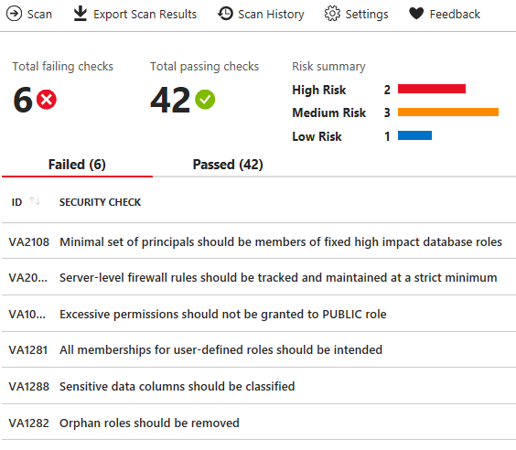
Vulnerability Assessment
Scans for database security vulnerabilities organized by severity
Findings provide actionable steps to remediate the issue
Set up periodic recurring scans and export reports
Covers database-level and server-level security issues
Notes:
SQL Vulnerability Assessment helps you identify database vulnerabilities - https://docs.microsoft.com/en-us/azure/sql-database/sql-vulnerability-assessment
Vulnerability assessment is an easy-to-configure service that can discover, track, and help you remediate potential database vulnerabilities. It provides visibility into your security state and includes actionable steps to resolve security issues and enhance your database fortifications.
Run a scan. The scan is lightweight and safe. It takes a few seconds to run and is entirely read-only. It doesn't make any changes to your database.
View the report for issues organized by severity.
Analyze the results and resolve issues. Drill down into each finding and what remediation actions are available.
You only need to turn on SQL Advanced Data Security once to enable Advanced Data Security features for all databases on your SQL Database server or managed instance. Enabling or managing Advanced Data Security settings requires belonging to the SQL security manager role, SQL database admin role, or SQL server admin role.

Slide 45
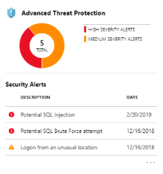
Advanced Threat Protection
SQL injection
SQL injection vulnerability
Data exfiltration
Unsafe action
Brute Force
Anomalous client login
Integrated with Azure Security Center to detect and respond to potential threats as they occur
Notes:
Azure SQL Database Advanced Threat Protection for single or pooled databases - azure/sql-database/sql-database-threat-detection#azure-sql-database-threat-detection-alerts
Threat detection provides a new layer of security that enables customers to detect and respond to potential threats as they occur, by providing security alerts on anomalous activities. Users receive an alert for suspicious database activities, potential vulnerabilities, SQL injection attacks, and anomalous database access and queries patterns. Threat detection integrates alerts with Azure Security Center, which includes details of suspicious activity and provides recommendations regarding investigating and mitigating the threat. Threat detection makes it simple to address potential threats to the database without the need to be a security expert or manage advanced security monitoring systems. Threat detection is part of the advanced data security (ADS) offering, which is a unified package for advanced SQL security capabilities. Threat detection can be accessed and managed via the central SQL Advanced Data Security portal.

Slide 46
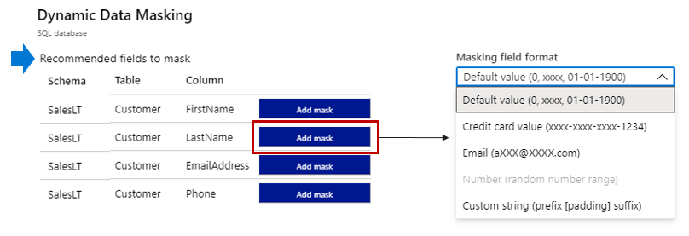
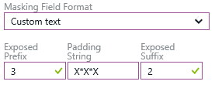
Dynamic Data Masking
Masks sensitive data for non-privileged users
Administrators are excluded; you can add others
Rules apply the masking logic; several formats are available
Notes:
Dynamic data masking for Azure SQL Database and Azure Synapse Analytics - https://docs.microsoft.com/en-us/azure/sql-database/sql-database-dynamic-data-masking-get-started
SQL Database dynamic data masking limits sensitive data exposure by masking it to non-privileged users.
Dynamic data masking helps prevent unauthorized access to sensitive data by enabling customers to designate how much of the sensitive data to reveal with minimal impact on the application layer. It’s a policy-based security feature that hides the sensitive data in the result set of a query over designated database fields, while the data in the database is not changed.
For example, a service representative at a call center may identify callers by several digits of their credit card number, but those data items should not be fully exposed to the service representative. A masking rule can be defined that masks all but the last four digits of any credit card number in the result set of any query. As another example, an appropriate data mask can be defined to protect personally identifiable information (PII) data, so that a developer can query production environments for troubleshooting purposes without violating compliance regulations.

Slide 47
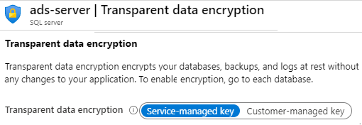
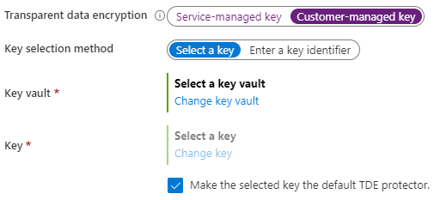
Transparent Data Encryption
Protects databases, backups, and logs at rest – server level
Real-time page level encryption and decryption - service or customer managed keys
OR
Supports Azure SQL Database (enabled by default), SQL Managed Instance , and Azure Synapse Analytics
Notes:
Transparent data encryption for SQL Database and Azure Synapse - https://docs.microsoft.com/en-us/azure/sql-database/transparent-data-encryption-azure-sql?tabs=azure-portal
Transparent data encryption (TDE) helps protect Azure SQL Database, Azure SQL Managed Instance, and Azure Data Warehouse against the threat of malicious offline activity by encrypting data at rest. It performs real-time encryption and decryption of the database, associated backups, and transaction log files at rest without requiring changes to the application. By default, TDE is enabled for all newly deployed Azure SQL databases. TDE cannot be used to encrypt the logical master database in SQL Database. The master database contains objects that are needed to perform the TDE operations on the user databases.
TDE needs to be manually enabled for older databases of Azure SQL Database, Azure SQL Managed Instance, or Azure SQL Data Warehouse. Managed Instance databases created through restore inherit encryption status from the source database.

Slide 48
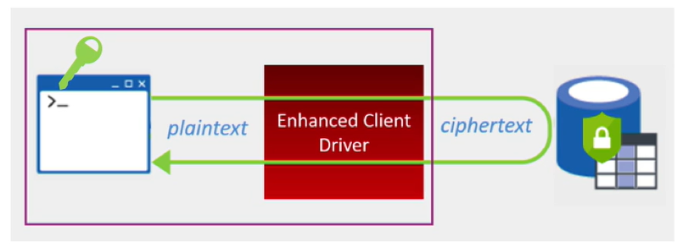
Always Encrypted
Protects sensitive data at rest, in transit, and in use
Database data always remains encrypted
Data access is only from client applications and servers
Uses client-side encryption – enhanced client driver
Separates data owners from data managers
Notes:
Always Encrypted - https://docs.microsoft.com/en-us/sql/relational-databases/security/encryption/always-encrypted-database-engine?view=sql-server-ver15
Always Encrypted is a data encryption technology in Azure SQL Database and SQL Server that helps protect sensitive data at rest on the server, during movement between client and server, and while the data is in use. Always Encrypted ensures that sensitive data never appears as plaintext inside the database system. After you configure data encryption, only client applications or app servers that have access to the keys can access plaintext data. Always Encrypted uses the AEAD_AES_256_CBC_HMAC_SHA_256 algorithm to encrypt data in the database.

Slide 49
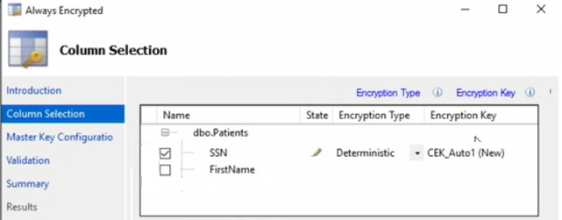
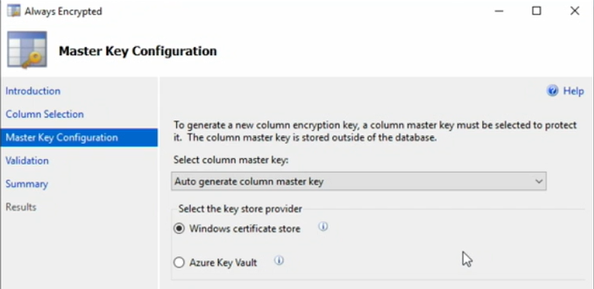
Always Encrypted - Implementation
SSN | First Name
1
Always Encrypted Wizard
Column Master Keys encrypt the data
Master Key protects the column master keys
3
4
2
5
Notes:
Always Encrypted: Protect sensitive data and store encryption keys in the Windows certificate store - https://docs.microsoft.com/en-us/azure/sql-database/sql-database-always-encrypted?view=sql-server-ver15
Identity the database table and the sensitive data columns that need to be encrypted. In this case, SSN. In SQL Server Management Studio view the table and select Encrypt Columns. This will launch the Always Encrypted wizard.
Select the columns you need encrypted.
Select the Encryption Type. There are two types: Deterministic and Randomized. Deterministic encryption always generates the same encrypted value for any given plain text value. Randomized encryption uses a method that encrypts data in a less predictable manner.
The Encryption Key can be autogenerated by the wizard. The key can be the same or different for each encrypted column.
The Master Key that encrypts the column master keys can also be autogenerated. It can be stored in the Windows certificate store or the Azure Key Vault.
SMSS is not the only tool you can also use T-SQL and PowerShell.

Slide 50
Demonstrations: Database Security
Advanced Data Security and Auditing
Diagnostics
AAD Authentication
Notes:
In the virtual classroom consider having the students join you in doing the demonstrations. Or you could have someone share their screen and be coached through the demonstration. Consider which demonstrations to provide given your student’s interests and the labs they will be assigned.

Slide 51
Additional Study – Database Security
Module Review Questions
Microsoft Learn Modules (docs.microsoft.com/Learn)
Provision an Azure SQL database to store application data (Exercise)
Secure your Azure SQL Database (Exercise)
Configure security policies to manage data (Exercise)
Migrate your relational data stored in SQL Server to Azure SQL Database (Exercise)
Notes:
For students who may be new to Azure or are struggling with the labs consider having them use their lab time going through the Learn modules instead.
(docs.microsoft.com/Learn)
Provision an Azure SQL database to store application data - https://docs.microsoft.com/en-us/learn/modules/provision-azure-sql-db/
Secure your Azure SQL Database - https://docs.microsoft.com/en-us/learn/modules/secure-your-azure-sql-database/
Configure security policies to manage data - https://docs.microsoft.com/en-us/learn/modules/configure-security-policies-to-manage-data/
Migrate your relational data stored in SQL Server to Azure SQL Database - https://docs.microsoft.com/en-us/learn/modules/migrate-sql-server-relational-data/

Slide 52
Module Labs

Slide 53
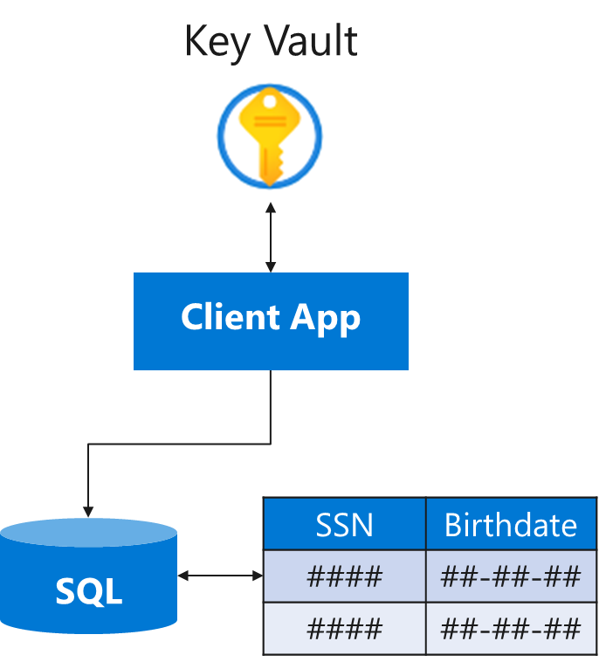
Lab 10 – Key Vault
Create a Key Vault and configure permissions
Add a key and a secret to the vault
Register a client app that uses the key
Create a SQL database
Encrypt columns in a table
Build a console app to test the encryption
Notes:
Lab scenario
You have been asked to create a proof of concept application that makes use of the Azure SQL Database support for Always Encrypted functionality. All of the secrets and keys used in this scenario should be stored in the key vault. The application should be registered in Azure Active Directory (Azure AD) in order to enhance its security posture. To accomplish these objectives, the proof of concept should include:
Creating an Azure key vault and storing keys and secrets in the vault.
Create a SQL Database and encrypting content of columns in database tables by using Always Encrypted.
Lab objectives
In this lab, you will complete the following exercises:
Exercise 1: Configure the key vault with a key and a secret
Exercise 2: Create an application to demonstrate using the key vault for encryption

Slide 54













Lab 10 – Key Vault
Exercise1, Task1
AZ500LAB10
Default Azure AD tenant
az500-10-vnet1 10.110.0.0/16
Exercise1, Task2, Task3, Task4
Exercise2, Task2
Exercise2, Task1
Subnet0 10.110.0.0/24
Key Vault
Access policy
az500kvxxxx
sqlApp
az500-10-vm1
10.110.0.4
MyLabKey
SQLPassword
SQL Server Management Studio
Exercise2, Task3, Task4
Visual Studio
Exercise2, Task5
medical
SQL Server
OpsEncrypt

Slide 55
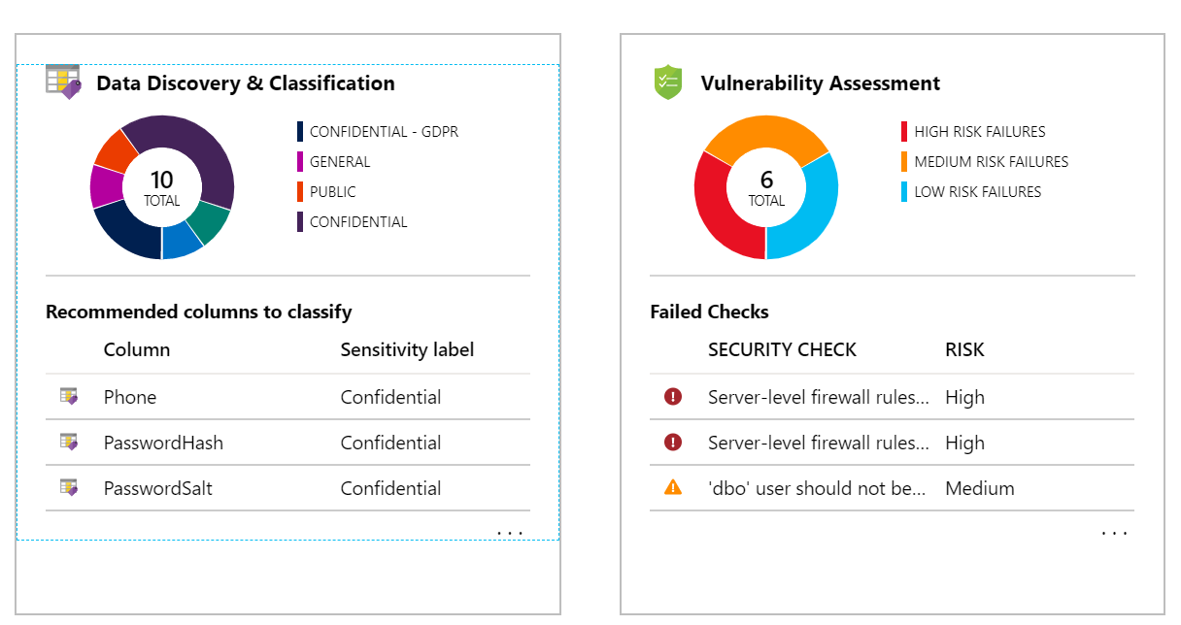
Lab 11 – Securing Azure SQL Database
Deploy an Azure SQL Database
Configure Advanced Data Protection
Configure Data Classification
Configure Auditing
Notes:
Lab scenario
You have been asked to review security features for Azure SQL database. Specifically, you are interested in:
Protection against attacks such as SQL injection and data exfiltration.
Ability to discover and classify database information into categories such as Confidential.
Ability to audit database server and database queries and log events.
Lab exercises
Exercise 1: Implement SQL Database security features

Slide 56



Lab 11 – Securing Azure SQL Database
Exercise1, Task1
AZ500LAB11
Exercise2, Task3
AZ500LabDb
Data Discovery & Classification
Exercise2, Task2
az500l11xxxx
Azure Defender for SQL
Exercise2, Task4
Auditing

Slide 57






Lab 12 – Service Endpoints and Securing Storage
Create a virtual network with a Public and Private subnet
Storage
Create a storage endpoint for the Private subnet
Create a storage account with a file share
Storage Endpoint
Configure a NSG with rules to allow access to storage and internet
Confirm storage access from the private subnet
Confirm storage access is denied from the public subnet
Public
Private
Notes:
Lab scenario
You have been asked to create a proof of concept to demonstrate securing Azure file shares. Specifically, you want to:
Create a storage endpoint so traffic destined to Azure Storage always stays within the Azure backbone network.
Configure the storage endpoint so only resources from a specific subnet can access the storage.
Confirm that resources outside of the specific subnet cannot access the storage.
Lab exercises
Exercise 1: Service endpoints and security storage

Slide 58




Lab 12 – Service Endpoints and Securing Storage
Exercise1, Task1
AZ500LAB12
myVirtualNetwork 10.0.0.0/16
Public 10.0.0.0/24
Exercise1, Task4
Exercise1, Task5, Task 7
Storage account
myVmPublic
10.0.0.4
Exercise1, Task2
Private 10.0.1.0/24
Service Endpoint
Microsoft.Storage
my-file-share
Exercise1, Task5, Task6
Exercise1, Task3
myVmPrivate
10.0.1.4
myNsgPrivate

Slide 59
End of presentation

